Slide 1

Analog Diagonal (45$°$) DRC free Path Digital Orthogonal ($90°$) DRC free Path

Slide 2
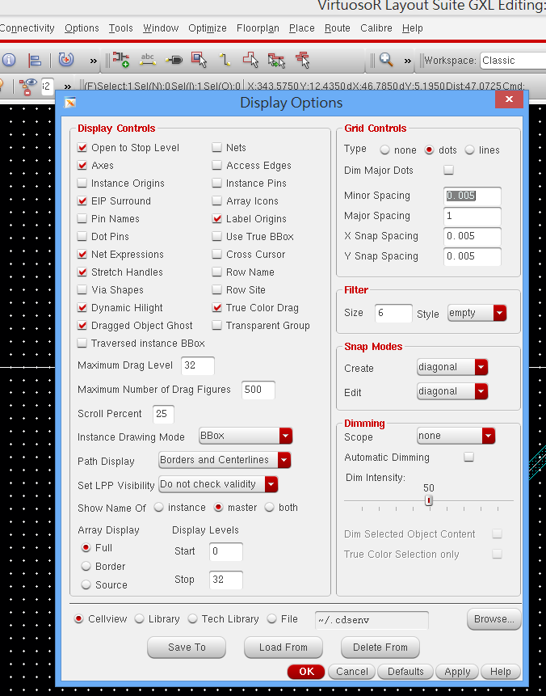
Check your Options-Display
Make sure “diagonal-mode” is selected.
The DRC free layout is only guaranteed under diagonal mode for analog path.
The DRC free layout is only guaranteed under orthogonal mode for dual-layer digital path.

Slide 3
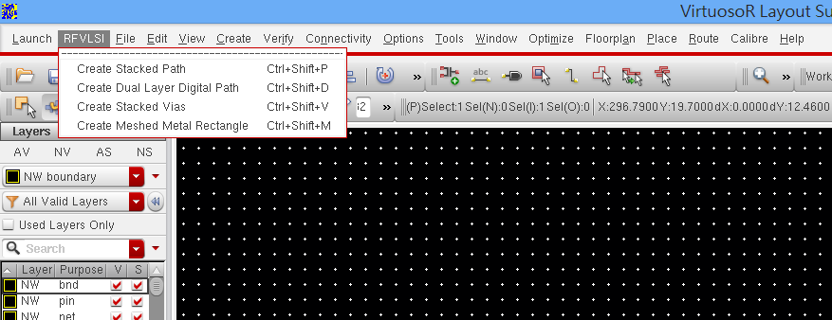
Use RFVLSI menu, select create path
You can also use bindkeys (Ctrl+Shift+P for example)

Slide 4
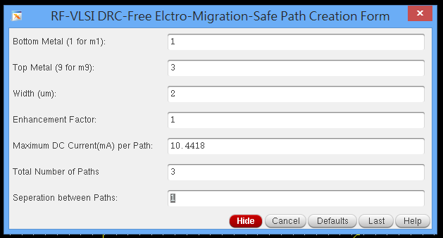
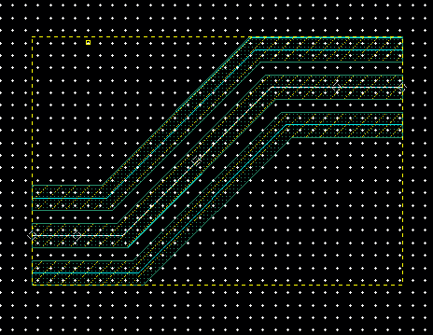
When you draw path, press F3 to change properties.

Slide 5
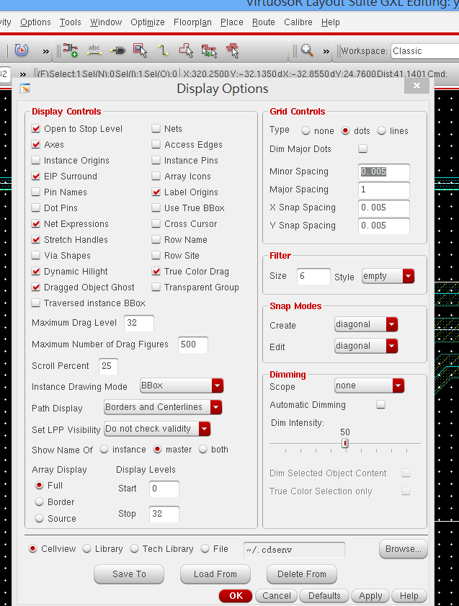
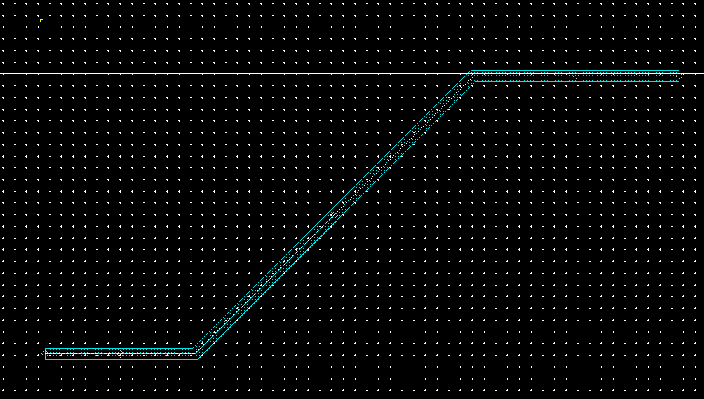
You can strench the path using “handles”

